Slide 1


Slide 2

Articles 18 and 19 address the right of women relating to sustainable environment participation and representation.
Article 18 reads partly:
“1. Women shall have the right to live in a healthy and sustainable environment.”
Article 19 provides under sub- b):
“ Women shall have the right to fully enjoy their right to sustainable development. In this connection, the States Parties shall take all appropriate measures to:
a) Introduce the gender perspective in the national development planning procedures’
b) Ensure participation of women at all levels in the conceptualisation, decision-making, implementation and evaluation of development policies and programmes;”
4. The topic under discussion is, “The Judiciary’s role in ensuring that women live in a healthy environment.”

Slide 3
True and fair enough, the Protocol calls upon States or Member Parties to engage in affirmative and concrete actions in ensuring the right of women to live in a healthy and sustainable environment and that they participate in decision making or plan of action. We often think of the Executive when it comes to such matters. The fact of the matter is, however, that we, as the members of the bench, form one of the critical arms of the Government or State as it were. We are the Judiciary. Our Chief Justice, Bheki Maphalala addressing the members of the Judiciary once stated, “Judges are the servants of the people.”
What did the drafters of Articles 18 have in mind when they promulgated that women have a right to live in a healthy and sustainable environment?
Generally, the right provided refer to a safe, clean, conducive and viable environment that would serve the present and future generations.

Slide 4


Of paramount, judges speak through their judgments. Lack of water for instant would more negatively impact on women than men. It is the women that must cook, clean, wash and bath the children. So, if a giant company use the river as a dumpsite, where litigation takes place, the judge is expected to lean in favour of protecting the river.
Again, to provide another example, where there is massive felling of indigenous trees or deforestation, an informed decision must consider that women use such indigenous trees as medicine for children and for cooking as well. Trees are also a good source of oxygen. A good judgment must consider and express an alternative to the use of wood for purposes of making fire. For instance, newspaper and other discarded forms of paper may be recycled. They are a good substitute for wood. Once recycled they can roast that beef.
There is an environment often taken for granted. This is the court’s environment. Its temperament is created by the nature of our legal system.

Slide 5
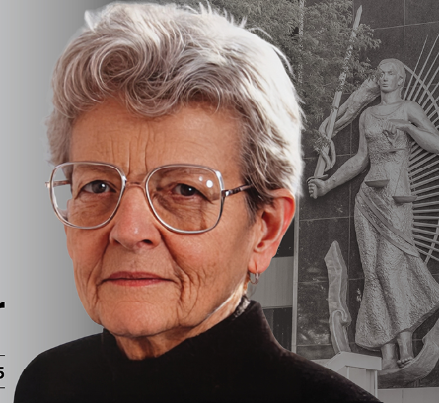
Most of our jurisdictions are under a legal system which is procedurally adversarial in nature. Justice Leonora Van den Heever sitting in the Court of Appeal had to warn Counsel, “Cross examination does not mean examining the witness crossly.” This is testimony that our courts tend to be unfriendly, frightening and intimidating which may cause palpitation, anxiety and other stress related health conditions. These therefore create an unhealthy environment which is contrary to the spirit of Article 18 of the Protocol.
How then do we align our adversarial system with Article 18?
As a short-term action, judges are expected to control the proceedings in their courts. The use of aggressive words or phrases such as “You are a lie or that is pure or green lies,” should be substituted with “You are mistaken or that is incorrect.” Harsh voices be toned down. Long and winding cross-examinations be guided.

Slide 6
In our respective jurisdictions, when we were faced with the plight of HIV/AIDS infection against children through sexual intercourse, we came out with what is referred to as Children’s Courts and the use of intermediaries. Can we create a set-up that will be user friendly for women as well as a long- term action?
Or adopt a much holistic approach by ensuring that matters commence at conciliation and mediation. Litigation be the last resort.

Slide 7
Thank you

