Slide 1
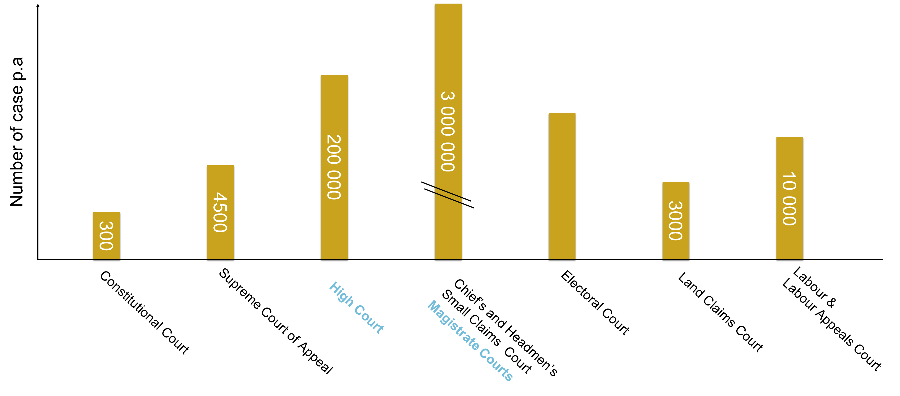
There is 1 Constitutional Court; 1 Supreme Court of Appeal and nine Divisions of the High Court in South Africa
(one in each province). There is one Regional Court Division for every High Court and there are 370 District Magistrates’ Courts.

